Slide 1
MACHINE LEARNING BASED MESS FOOD SAVER
TEAM NAME: IGNITED MINDS

Slide 2
Agenda
Problem Description
Machine Learning Context
Solution framework
Solution framework- DFD & ER
Data Description
Machine Learning Models and Validation
Enhancements in Pipeline- Model Error Correction
Web-Application

Slide 3
Problem Description
Reduce the Wastage of Food in Mess
Ascertain the Quantities of Items to be prepared
Automatic Feedback Mechanism to adjust the quantities
Student Feedback and Analysis

Slide 4






Machine Learning Context
Footfall always have some recent , some seasonal patterns
Competencies of Mess Managers to determine food quantity is just a wild assumption which varies a lot
ML is the way to predicting the number of people going to dine in next shift.
Use the predicted counts to determine the Quantity of food to be prepared
Adjust the per student consumption as per the recent trends(model correction)
Features
Count of students in Mess shows both seasonal and recent trends
Features creation capturing both these trends
Data
Exploratory Analysis
Model data creation
Modeling
Validation
Output
Mess DB
Trend Analysis
Plots
Dashboard
Feature Engineering
Machine learning
Constrained by the data

Slide 5
Solution Framework
MySQL
Machine Learning Models ( Server )
Machine Learning Models ( Server )
Web Application (Client)
Web Application (Client)
Student
Patient
Doctor
Manager
Patient dashboard
Doctor dashboard
Manager dashboard
Python and Flask
Python and Flask
Backend
Backend

Slide 6


Solution Framework
Table : Historic_Data
Table: Weekly_MenuPlanner
Table: consumption table
Table: Reviews
Table: Stock
Mess Monitoring Portal
Login Page
Dashboard
Stock
Predicted Results
Student Reviews
Mess DataBase
Machine Learning model

Slide 7
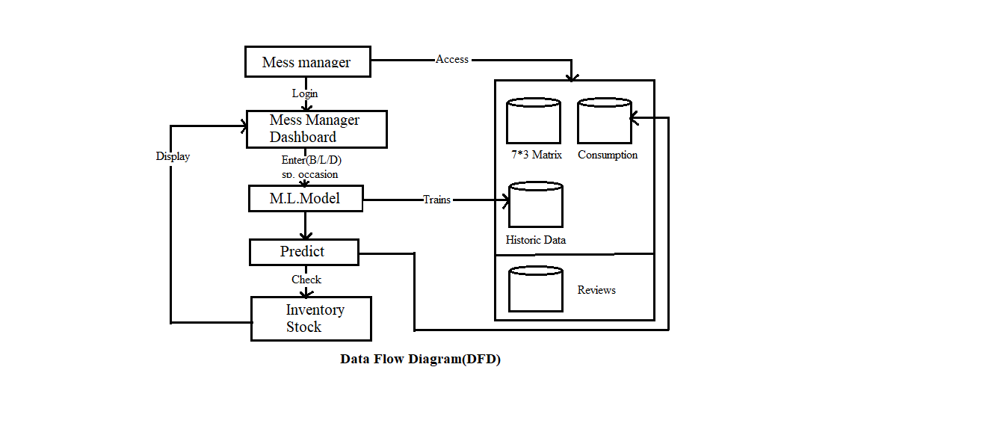
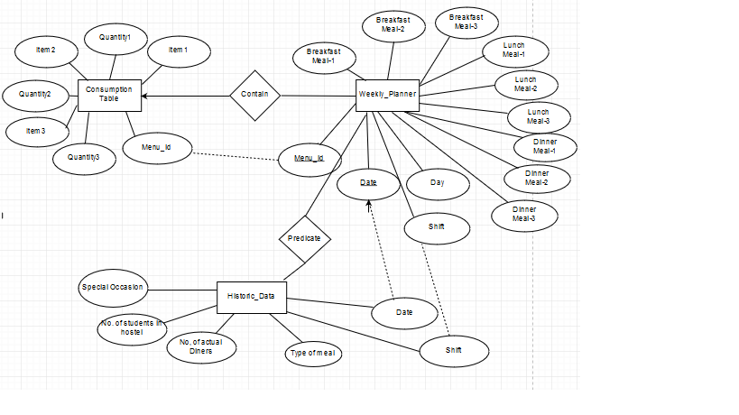
Solution Framework- DFD & ER

Slide 8
Given Data Description
Historic_Data
Special_Occasion | Date | No_of_Students_in_Hostel | No_of_Actual_Diners | Type_Of_Meal | Mess_No
Regular | 04-12-2017 | 581 | 590 | B | 0
Regular | 04-12-2017 | 660 | 402 | B | 1
Regular | 04-12-2017 | 588 | 413 | B | 2
Weekly Menu Planner
Day | B_Menu_Item1 | B_Menu_Item2 | B_Menu_Item3 | L_Menu_Item1 | L_Menu_Item2 | L_Menu_Item3 | D_Menu_Item1 | D_Menu_Item2 | D_Menu_Item3
Mon | XX | YY | ZZ | XX1 | YY1 | ZZ1 | XX2 | YY2 | ZZ2
Tue | XX | YY | ZZ | XX1 | YY1 | ZZ1 | XX2 | YY2 | ZZ2
Wed | XX | YY | ZZ | XX1 | YY1 | ZZ1 | XX2 | YY2 | ZZ2
Consumption
Menu_Item | Ingredient_1 | per_student_consumption_Ing_1 | Ingredient_2 | per_student_consumption_Ing_2 | Ingredient_3 | per_student_consumption_Ing_3
XX | I1 | 1 | I2 | XX1 | I5 | 1
YY | I1 | 3 | I4 | XX1 | I4 | 2
ZZ | I2 | 2 | I3 | XX1 | I2 | 3
Columns in Black represent Given data
Columns in Red represent additional suggested columns that can be used
Reviews
Student ID | Date | Type_of_meal | Rating | Comments
1111 | 04-12-2017 | B | 4 | Dal was not good

Slide 9
Feature Engineering
Necessary to club features for analysis
Response Variable for Machine Learning model is to predict the count of people to Dine
Special Occasion –Capture Last day of Exam, Exam, Capture variability in the attendance pattern during fests, Holidays
Season
Weekend , Weekdays represented by Day of Week
Recent Features –Last 4 shift count in hostel and mess, average count of students in Mess and hostel in (Special Ocassion-1 ) day
Menu Items, Ingredients and Makers as Additional Features. (Ingredients and Makers may be important)
Model Ready Data
Date | Month | Day of Week | Type of Meal | No of Students in Hostel(Real Time) | Special Occasion_1 | Special Occasion_2 | Special Occasion_3 | No of Student in Hostel in Shift-1 | Number of Students dined in PresentShiftminus1 | No of Student in Hostel in PresentShiftminus2 | Number of Students dined in PresentShiftminus2 | No of Student in Hostel in PresentShiftminus3 | Number of Students dined in PresentShiftminus 3 | No of Student in Hostel in PresentShiftminus4 | Number of Students dined in PresentShiftminus4 | Menu_item_1 | Menu_Item_2 | Menu_item_3 | Actual People Dined
New_Menu | Menu_Item1_Ingr_1 | Menu_Item1_Ingr_2 | Menu_Item1_Ingr_3 | Menu_Item2_Ingr_1 | Menu_Item2_Ingr_2 | Menu_Item2_Ingr_3 | Menu_Item3_Ingr_1 | Menu_Item3_Ingr_2 | Menu_Item3_Ingr_3 | Menu1_Prepared_By | Menu2_Prepared_By | Menu3_Prepared_By_1 | Exam_day_&_Exam_day_plus1 | Average_No_of_People_present_before_Event or Average Last Day

Slide 10
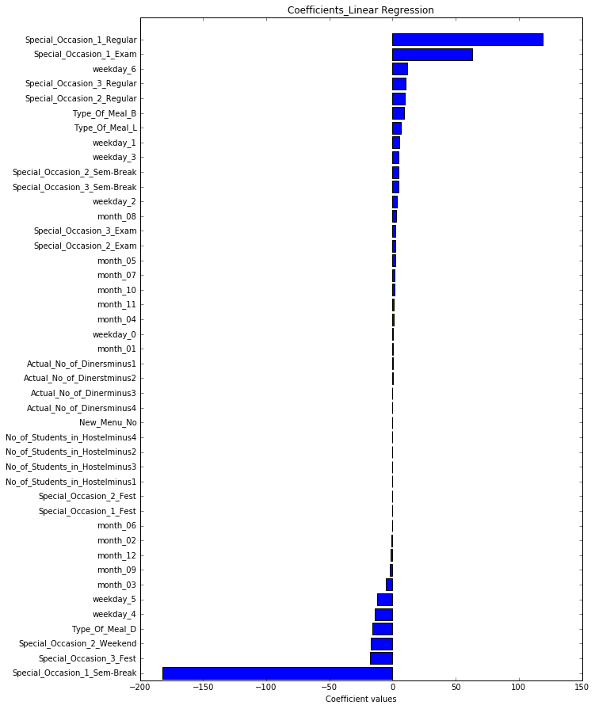
Models
Implemented Linear Regression on Manually Generated Dataset
Coefficients from Linear Regression can tell the reasons behind the mismatch
Correction of the Model based on the feedback is in progress. (Change in per student Quantity)
Model Results & Validation
MSE: 1135.0813
RMSE: 33.68 R-Square->0.91

Slide 11
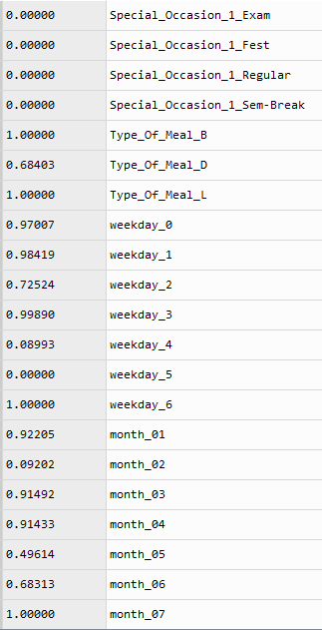
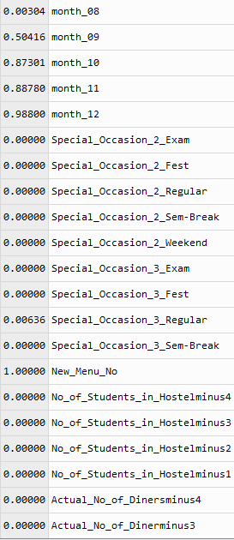

p-values—Linear Regression

Slide 12
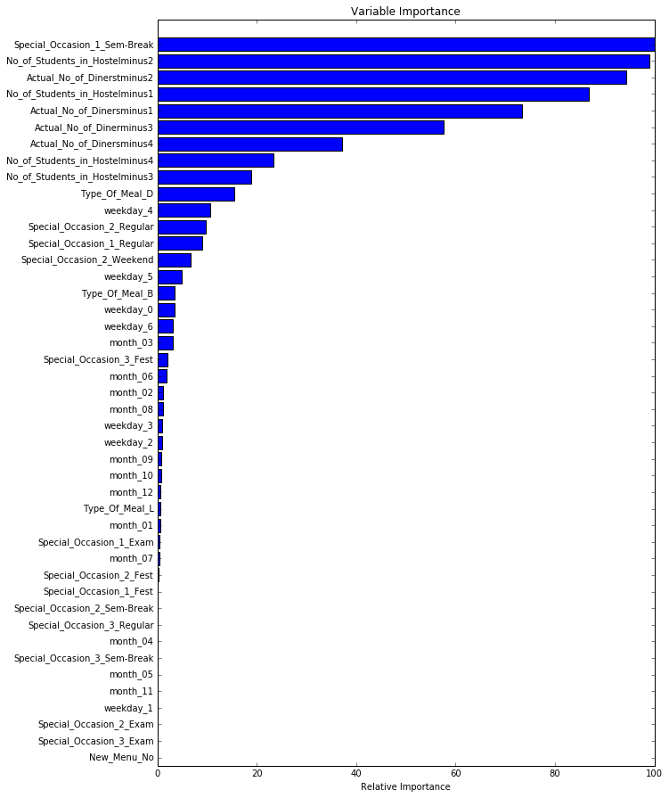
Model Results & Validation
Gradient Boosting Regression
MSE: 1132.0813
RMSE: 33.64
params = {'n_estimators': 500, 'max_depth': 4, 'min_samples_split': 2,
'learning_rate': 0.01}

Slide 13
Enhancements in Pipeline- Model Error Correction
Chained optimization at two levels:
a. Number of Students Dining
b. per_student_consumption of a Menu item
Aggregate Wastage might not be the clear Indicator. Separate menu item wise wastage should be checked.
If a Menu Item is having continuous large wastage, reduce the consumption_per_student of the Menu Item.
This is absolutely at the discretion of the Mess Manager- Can be decided using some optimisation using:
e.g.
Consumption_per_student_item-avg_wastage_of_item_in_last_week_per_student

Slide 14
THANK YOU

